Slide 1

CS574 Object-Oriented Analysis & Design
CS574 Lecture 1: Introduction
In this course you will learn how to use object-oriented analysis & design techniques to:
Interact with a client to determine the requirements for a new software application or system that is to be developed for him/her
and eventually end up with an object-oriented design for that application/system, a design that you, or someone else, can then code, test, install, maintain, and enhance. (We won’t be talking (much) about anything past design here.)‏
The only background assumed is: (i) that you have some experience programming in any one of the object-oriented languages, e.g., Java, C++, C#; i.e., that you have a basic idea of what object orientation is all about.

Slide 2
CS574 Object-Oriented Analysis & Design
UML
We will be using the industry-standard Unified Modelling Language (UML) notation -- plus English text -- in representing the results of some of our work, i.e. our analyses and designs.
In this lecture we will start looking at UML class diagrams.
We will eventually need a UML drawing tool. Meanwhile, you can draw the few UML class diagrams that you will have to draw using MS PPT or MS Word drawing tools.

Slide 3
CS574 Object-Oriented Analysis & Design
GUIs
Fairly early on in the course you will also be drawing GUI diagrams.
Any GUI-drawing tool will do that allows you to copy diagrams in .jpg format and paste them into MS Word documents or .ppt documents.
So, if you don’t already have a GUI diagram drawing tool, please find one that you’re comfortable with.

Slide 4
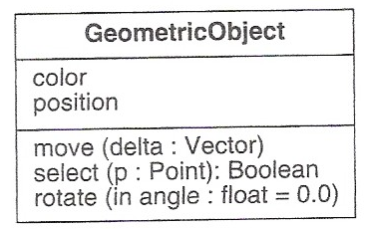
CS562WS DBMS II
CS574 Object-Oriented Analysis & Design
UML Class Notation Part I
The diagram below is a UML class diagram for a class named GeometricObject that has
Attributes named “color” and “position”
Operations named “move,” “select,” and “rotate.” (Note that, technically speaking, a “method” is the implementation of an operation, so, in this diagram, move, select, and rotate are operations rather
than methods.)

Slide 5
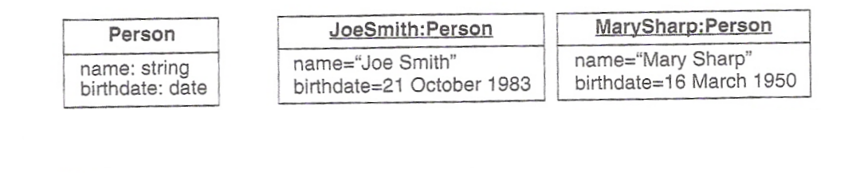
CS562WS DBMS II
CS574 Object-Oriented Analysis & Design
Object Diagrams
The diagrams below include:
On the left: a class diagram for a class called “Person” with attributes “name” and “birthdate,” but with no operations specified – perfectly legal in a class diagram
To the right of the diagram for Person:
An object diagram for a JoeSmith instance of class Person
An object diagram for a MarySharp instance of class Person
Note that the name of each object and the name of the class of which it is an instance are underlined in an object diagram.

Slide 6
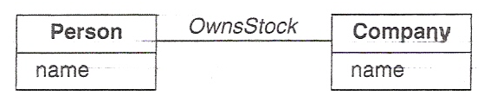
CS562WS DBMS II
CS574 Object-Oriented Analysis & Design
Associations
If we were working on a financial application we might want to have a class called “Person” and a class called “Company.”
If, for the purposes of our application, we needed to keep track of the fact that specific instances of Person own stock in specific instances of Company, then we would represent that fact in a class diagram such as the one below.
The relationship “OwnsStock,” which goes from Person to Company, is called an Association.

Slide 7
CS562WS DBMS II
CS574 Object-Oriented Analysis & Design
Associations (cont.)
Objects correspond to entities and classes correspond to entity sets.
The major difference is that while entity sets have attributes and entities have attribute values, entities and entity sets don’t come with anything corresponding to operations.
Entity sets can have relationships between/among them, and so can classes, but they’re not called “relationships;” rather, they’re called “associations.”

Slide 8
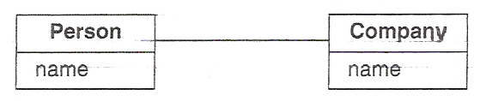
CS562WS DBMS II
CS574 Object-Oriented Analysis & Design
Associations (cont.)
Let’s have one more look at the class diagram two slides back.
Having been through the software development wars for more than 45 years, and having learned the hard way how disastrous unclear documentation can be, I happen to be a fanatic about readability of documentation.
If we were just a bit more careful, and named the association “OwnsStockIn,” rather than “OwnsStock,” then it is far less likely that some maintenance or enhancement person a few years down the line will be the slightest bit puzzled by what the association is about.
Think of it this way: If the association is named “OwnsStockIn,” then, if we read from left to right, the diagram says “(A) person owns stock in (a) company,” i.e., it describes precisely, in a well-formed English sentence, what the association is.
Note that on the following slides we will often see class diagrams taken from various textbooks and published papers that are badly designed and that will be criticized and improved.
OwnsStockIn

Slide 9
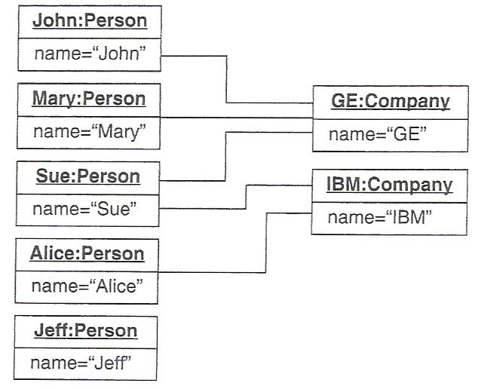
CS562WS DBMS II
CS574 Object-Oriented Analysis & Design
Links
Relationships between classes are called “associations.”
But relationships between objects are called “links.”
The lines in the object diagram below are, therefore, “links.”
They indicate that:
The Person John owns stock in the Company GE
Mary also owns stock in GE
So does Sue
Sue also owns stock in IBM
So does Alice
Jeff doesn’t own stock in any company

Slide 10
CS562WS DBMS II
CS574 Object-Oriented Analysis & Design
Naming Links
For the sake of readability, especially where the context isn’t absolutely clear – e.g., the diagram might be about employment of instances of Person by instances of Company, or it might be about both ownership of stock and employment, I would put the link name, in this case “OwnsStockIn,” on every link that has to do with stock ownership.
OwnsStockIn
OwnsStockIn
OwnsStockIn
OwnsStockIn
OwnsStockIn

Slide 11
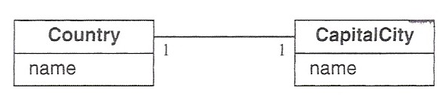
CS562WS DBMS II
CS574 Object-Oriented Analysis & Design
Multiplicity: 1-to-1
The two 1’s in the following class diagram introduce the notion of “multiplicity:”
HasCapital
The sentence “A country has capital a capital city” makes no sense in English.
But the sentence “A country has as its capital a capital city” does make sense, so I would rather write the diagram as follows:
HasAsItsCapital

Slide 12
CS562WS DBMS II
CS574 Object-Oriented Analysis & Design
Multiplicity: 1-to-1 (cont.)
We haven’t yet, however, discussed what “multiplicity” means or what the two 1’s have to do with multiplicity in this diagram
HasAsItsCapital
The two 1’s mean that “A country has as Its capital exactly 1 capital city,” and that
“a capital city is had as its capital city by exactly 1 country.” (Note that, unless specified otherwise, an association is intended to be read from left to right; if we have to read it from right to left, we simply use the passive voice, e.g., “is had as its capital city by.”)

Slide 13
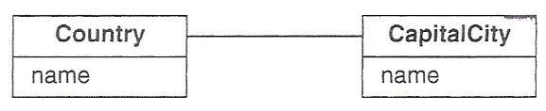
CS562WS DBMS II
CS574 Object-Oriented Analysis & Design
Multiplicity: 1-to-(0 or1)
If we wanted to say that a country needn’t have a capital city, but that if it has capital city, then it can have at most one capital city, we would draw the diagram as:
HasAsItsCapital
1
0..1
That is, 0..1 means “zero or one.”
In other situations, i.e., ones not having to do with countries and their capital cities, we might want to say that instances of some class, C1, can be associated with between zero and, say, three instances of some other class, C2; in this case we would use the multiplicity notation “0..3.” In other circumstances we might use notation such as “1..3” or “2..6,” etc.

Slide 14
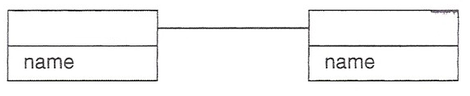
CS562WS DBMS II
CS574 Object-Oriented Analysis & Design
Multiplicity: (0 or 1)-to-1
On the other hand, if our application involved cities in general, rather than just capital cities – much more likely – then the diagram would likely be as follows:
HasAsItsCapital
Country
City
0..1
1
which would be read as
A country has as its capital exactly one city
and a city is had as its capital by zero or one countries = a city is the capital of zero or one countries = a city is the capital of at most one country.
In the general case, if a diagram connects a class C1, on the left, by an association A, to a class C2 on the right, then the diagram can be read as “an instance of C1 A’s an instance of C2” or “an instance of C2 is A’ed by an instance of C1.”

Slide 15
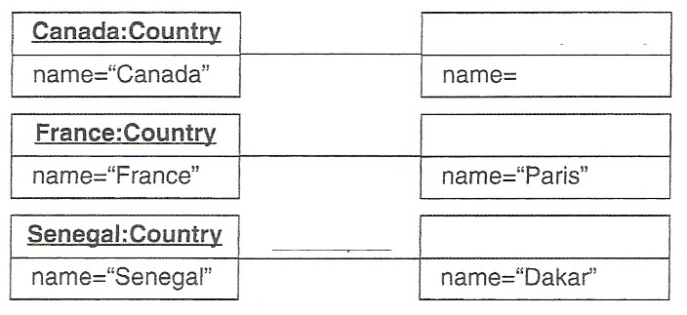
CS562WS DBMS II
CS574 Object-Oriented Analysis & Design
Multiplicity: (0 or 1)-to-1
The following object diagram is consistent with the class diagram on the previous slide.
HasAsItsCapital
Ottawa:City
HasAsItsCapital
Paris:City
HasAsItsCapital
Dakar:City

Slide 16
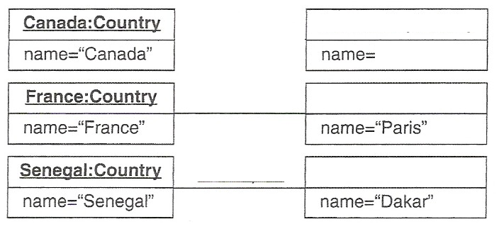
CS562WS DBMS II
CS574 Object-Oriented Analysis & Design
Multiplicity: (0 or 1)-to-1
The following object diagram is also consistent with that class diagram.
Toronto:City
HasAsItsCapital
Paris:City
HasAsItsCapital
Dakar:City

